Slide 1
Cloud Computed Web Application for Range Planning and Core Tracking
GRADUATION PROJECT
Rhythm Sharma
MFT –IV
NIFT, Bengaluru

Slide 2
RANGE PLANNING
Assortment planning process
Amount of merchandise choice
Breadth
Depth

Slide 3
Introduction
Range planners - Microsoft Excel
Same set of processes are repeated

Slide 4
Objectives
Eliminating manual processes involved in making a Range Plan and replacing it with a software for forecasting
IT integration and automation in planning department

Slide 5
Current process
Manual activities
Template
Dump

Slide 6
Manual activities
Collect last season sales data dump
Calculate fields as per formulae
Aggregate data according to brand, group and category
Make pivot
Paste it in a range planner template
Replace values with assumptions
Paste next season assumptions
Formula driven fields get calculated

Slide 7
Input
Aggregation, formulae, auto calculations
Output
Software
Reports
Dump
Frontend (UI) - HTML, CSS
Backend- Ruby Language, Rails (framework)
Database- SQLite
4

Slide 8
Before
Manual effort
Template
Dump
After
Software
Reports
Dump

Slide 9
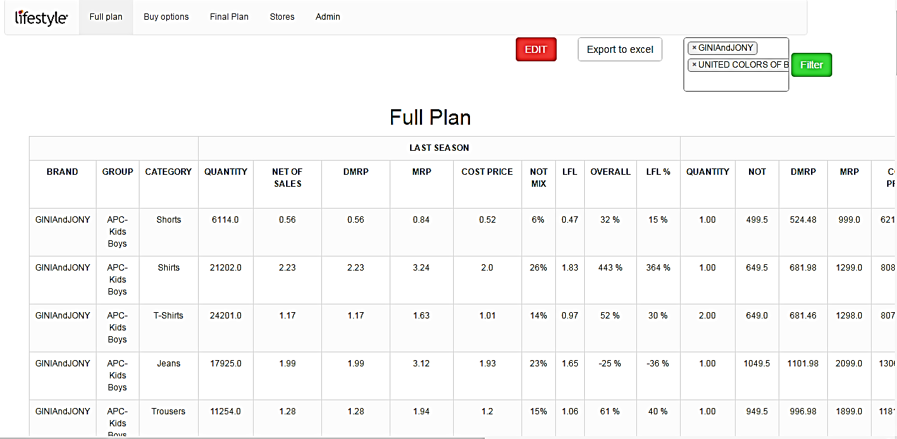

Slide 10
RANGE PLAN: END RESULTS
Need of eliminating manual work done to develop a range plan was identified by automating processes
A software was developed to replace those activities
Time was reduced to develop a range plan from a few days to a few hours
Range plan developed automatically

Slide 11
CORE TRACKING
Analyzing or tracking all the sales dump data of core styles for private labels
Overall availability of these core styles
Tracking buffer and stock levels of these core styles

Slide 12
Introduction
No existing process for analyzing core sales data

Slide 13
Objectives
Tracking core styles according to sales of previous and current year along with growth and giving a visual representation for analysis
Analysis or tracking of core sales data according to buffer level and stock level for each core style
IT integration and automation in planning department

Slide 14
Output
Input
Query, formulae,
Data mining
Software
Templates
Dump
Frontend (UI) - HTML, CSS
Backend- Ruby Language, Rails (framework)
Database- SQLite
4

Slide 15
CORE TRACKER REPORTS
Status of the buffer level above optimum level
Status of the buffer level below optimum level
Display styles where ARP value is not entered indicating manual error or style is obsolete
ARP<SOH
Overall Availability
Sum of previous year sales quantity bar graph with current year sales quantity with change in growth for the same style

Slide 16
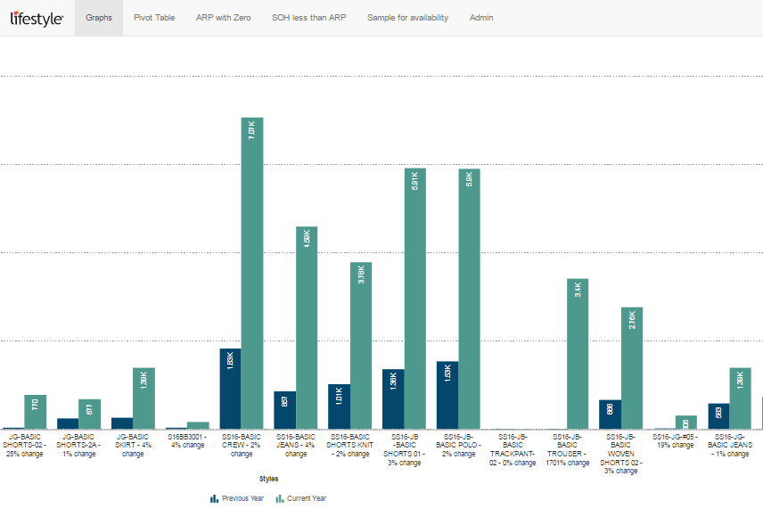
Current year sale quantity
Previous year sale quantity

Slide 17
CORE TRACKER: END RESULTS
Tracked sales quantity data of previous and current year visually with growth
No existing processes were in place so the available weekly core sales data dump was used to track core sales
Overall availability of core styles was tracked across all stores
The availability was tracked style wise
Plan is available to the user to take necessary action within a day’s notice
Easier reading of data due to visual representation

Slide 18
Conclusion
Eliminating human errors
Eliminating redundancy of work
Centralising data on cloud
Tracking and forecasting
Generating various reports
Taking corrective actions quickly

Slide 19
THANK YOU

